Slide 1
GROCERY LISTING APPLICATION
TEAM MEMBERS
BOOBATHI .A 812421104015
DURAIMURUGAN .G 812421104019
ISMAIL.S 812421104035
MOHAMED FOUZI .M 812421104057
MOHAMED THOUFIC .B 812421104061
PROJECT GUIDE
Mrs. K. DASARATHI SHOHI M.E.,
ASSISTANT PROFESSOR
Department of Computer Science and Engineering

Slide 2
OBJECTIVE
To streamline grocery list management by providing a user-friendly mobile application that allows users to create, modify, and share grocery lists effortlessly. The app integrates advanced features like Excel file handling, PDF generation, and secure user authentication to enhance efficiency and accessibility for everyday shopping needs.

Slide 3
INTRODUCTION
The Grocery Listing Application is a comprehensive mobile solution designed to revolutionize the way users manage their grocery shopping. By offering advanced features and a user-friendly interface, the app empowers users to handle their grocery lists effortlessly and efficiently.
The application allows users to import data directly from Excel files, enabling quick setup for grocery lists based on pre-existing data. Once imported, users can dynamically update their lists by adding new items, removing unnecessary ones, or editing quantities and details.
After completing their updates, users can export the final list in PDF format, enabling seamless sharing with shopkeepers, family members, or friends. This functionality eliminates the hassle of manual list creation and promotes a more professional and organized approach to shopping.

Slide 4
Secure login and signup features are implemented using Shared Preferences, ensuring users can safely access their personalized settings and grocery data. Additional features like Light/Dark Mode customization enhance the app’s usability, catering to user preferences and providing an optimal experience in various environments.
Designed using modern technologies and best practices, the Grocery Listing Application focuses on delivering performance, reliability, and scalability. It offers an all-in-one platform for managing grocery lists, making it an invaluable tool for individuals and families seeking to streamline their shopping processes.
By combining convenience with practicality, the Grocery Listing Application sets a new standard for grocery planning, saving time and effort while offering a seamless, tech-driven solution.

Slide 5
LITERATURE SURVEY
S/N | Title | Author & Year of Publication | Concept | Techniques | Advantages | Disadvantages
1 | Optimized Grocery List Management | James Carter, 2024 | Efficient list creation | Use of shared preferences | Faster access to personalized lists | Limited to device storage
2 | PDF Generation for User Applications | Linda Wilson, 2023 | PDF export integration | iText library | Simplifies list sharing | Formatting limitations in complex data
3 | Dynamic File Handling in Mobile Apps | Robert Harris, 2022 | File import/ export | Integration with Apache POI | Seamless Excel file handling | Large files may impact performance

Slide 6
S/N | Title | Author & Year of Publication | Concept | Techniques | Advantages | Disadvantages
4 | Improving User Experience in Mobile Applications | Emily Davis, 2023 | UI/UX enhancements | RecyclerView for data display | Interactive and user-friendly interface | Higher initial design complexity
5 | Data Synchronization in Offline Applications | Sarah Green, 2024 | Offline mode support | Data caching techniques | Uninterrupted usage without network | Risk of outdated data if not synced

Slide 7
EXISTING SYSTEM
Traditional methods like handwritten notes or basic apps are inefficient and error-prone.
Most systems lack Excel integration, requiring manual data entry, which is time-consuming.
Customization options are limited, with static interfaces that don’t support dynamic edits.
Sharing lists is difficult, with no easy way to export them as PDFs for sharing.
Secure login and personalized features are often missing, leaving user data unsecured.

Slide 8
PROPOSED SYSTEM
User-Friendly Interface:
The Grocery Listing Application offers a simple and intuitive interface that makes it easy for users to create, modify, and manage their grocery lists. The design ensures a smooth and efficient experience, allowing users to navigate through the app effortlessly.
Dynamic Grocery List Management:
Users can import grocery data from Excel files and edit their lists by adding, removing, or modifying items. This flexibility allows users to tailor their grocery lists to their needs without limitations.
Excel Integration:
The app supports seamless integration with Excel files. Users can create a grocery list, export it to Excel, and make changes as necessary. The app also allows users to re-import the modified files to keep their grocery lists up-to-date.

Slide 9
PDF Export:
Once users have updated their grocery lists, they can export the list into a PDF format. This feature makes it easy to share the list with others, such as grocery shopkeepers or family members, for placing orders.
Future Enhancements:
Future versions of the app could include additional features like cloud synchronization for easier access to grocery lists across multiple devices, as well as advanced sharing options to allow users to share their lists in different formats and platforms.

Slide 10
SYSTEM ARCHITECTURE
Splash screen
Sign up
Reset password
Login
Forgot password
Logout
Drawer Layout
Action
Bottom Menu
Settings
Help
Home
Import
Your files
Grocery items
Excel files at user Mobile
Generated files[PDF or Excel]
Change theme
Generate Excel
Select items
Add Row
Save Excel
Share
Open files

Slide 11
SOFTWARE REQUIREMENTS
Operating System: 64-bit Windows 10 or higher/ macOS / Linux
Frontend: XML (User Interface Design)
Backend: Kotlin (Application Logic and Integration)
Database: Shared Preferences (For Local Storage of User Data and Preferences)
IDE: Android Studio
HARDWARE REQUIREMENTS
Processor: x86_64 CPU architecture; 2nd generation Intel Core or newer, or AMD CPU
Hard Disk: Minimum 10GB (to accommodate Android Studio and project files)
Memory: Minimum 8 GB, recommended 16 GB or more

Slide 12
MODULES WITH DESCRIPTION
1.Login/Signup Module
Description: Ensures secure access to the app by allowing users to log in or sign up for a new account. This module offers a personalized experience, saving user preferences and maintaining session data for convenience.
Features:
Shared Preferences for storing user login credentials securely.
Automatic login for returning users.
Password recovery and account creation features.

Slide 13
2. Home Module
Description: This module serves as the starting point for users, providing preloaded grocery categories to help them quickly create a customized list. Users can select items from predefined options or add new ones, enabling them to efficiently manage their grocery planning.
Features:
Preloaded grocery categories with editable item lists.
Checkbox options to select required items.
Create and save the list as an Excel file stored in the device's downloads folder.

Slide 14
3. Import Excel Module
Description: This module simplifies the process of importing existing or previously created grocery lists. Users can load files directly from their device storage, making it easy to update or edit lists without starting from scratch.
Features:
Easy file import from the device’s storage.
Dynamic display of imported Excel data in a grid format.
Add, edit, or delete items within the list.

Slide 15
4. Your Files Module
Description: A central repository for managing and displaying all files created or edited through the app. Users can browse their saved Excel and PDF files, ensuring easy access for future modifications or sharing.
Features:
List view of all saved Excel and PDF files.
Open and modify any saved file directly within the app.
Buttons to share PDF files for easy communication with shopkeepers.

Slide 16
5. PDF Export Module
Description: This module allows users to finalize their grocery list in a professional and portable format. With the click of a button, users can generate a well-structured PDF that can be shared directly with shopkeepers or other stakeholders.
Features:
Convert edited lists into a well-structured PDF.
Direct sharing options for seamless communication.
Retains formatting for professional appearance.

Slide 17
6. Settings Module
Description: Offers personalization and customization options to enhance user experience. This module allows users to adjust the app's theme, manage their account, and ensure a comfortable interface tailored to their preferences.
Features:
Light/Dark mode switching.
Option to log out or reset the app.
Preference management for theme and UI settings.

Slide 18
ADVANTAGES
Efficient Organization:
Helps users systematically manage grocery items, ensuring all essential products are included in the list.
User-Friendly Interface:
A clean and intuitive design allows users of all skill levels to easily navigate and operate the app.
Time-Saving:
Quickly import, edit, and export lists without the need for manual effort or repetitive tasks.
Accessible Anytime:
Users can access their saved lists and files anytime, directly from their mobile device.

Slide 19
Customizable Lists:
The app allows dynamic editing of grocery lists, giving users flexibility to add, update, or remove items as needed.
Seamless Sharing:
Export lists to PDF and share with shopkeepers or others with just a few clicks, simplifying communication.
Secure Experience:
The use of Shared Preferences ensures safe storage of user credentials and preferences.
Portable Convenience:
Manage grocery lists on the go, eliminating the need for paper-based lists.

Slide 20
FUTURE ENHANCEMENT
Online Shopping Cart
Allow users to add selected grocery items to a cart for an easy and organized checkout process.
Users can edit quantities, remove items, and review their selections before completing the purchase.
Enable users to save their cart for future purchases or modifications.

Slide 21
Cloud Synchronization
Enable users to access their grocery lists from multiple devices by syncing with the cloud.
Ensure real-time updates across all devices, so users can make changes wherever they are.
Enhanced Sharing
Allow users to share grocery lists in multiple formats like Excel, PDF, or text.
Enable direct sharing via social media platforms, email, and messaging apps.

Slide 22
File Import Flexibility
Enable users to import grocery lists in any file
format (e.g., Excel, CSV, PDF).
Automatically detect and convert the imported files into
editable formats within the app.
Provide a simple interface to view and modify imported files seamlessly.
AI Recommendations
Suggest grocery items based on the user's shopping history and preferences.
Offer recipe ideas or meal plans based on the items selected,
enhancing the shopping experience.

Slide 23
CONCLUSION
The Grocery Listing Application provides a comprehensive and user-friendly solution for managing grocery lists. It simplifies the process of list creation, modification, and sharing through features like Excel import/export,dynamic list editing, and PDF generation. The integration of secure user authentication ensures a personalized and seamless experience, while the addition of theme customization enhances usability.by offering an intuitive interface and robust functionalities, the application saves time and effort for users, making it an ideal tool for everyday grocery management.Its modular design and scalability provide ample scope for future enhancements, making it a reliable and efficient solution for both individuals and families.

Slide 24
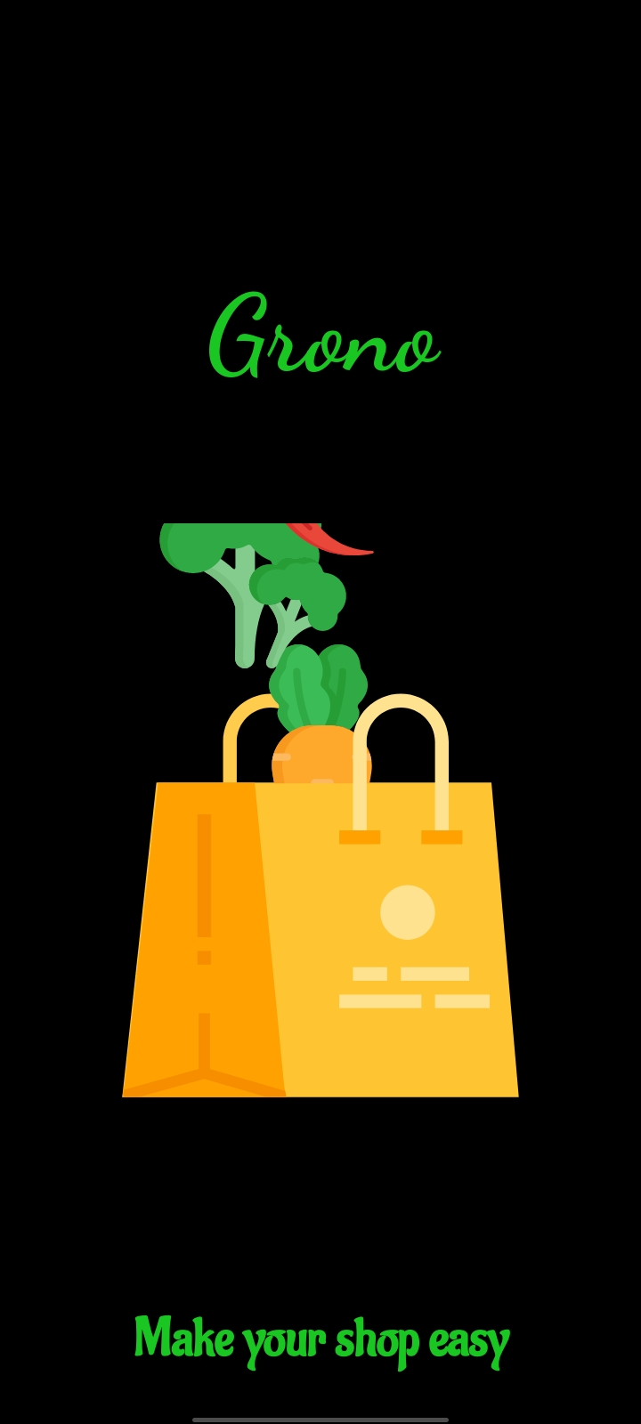
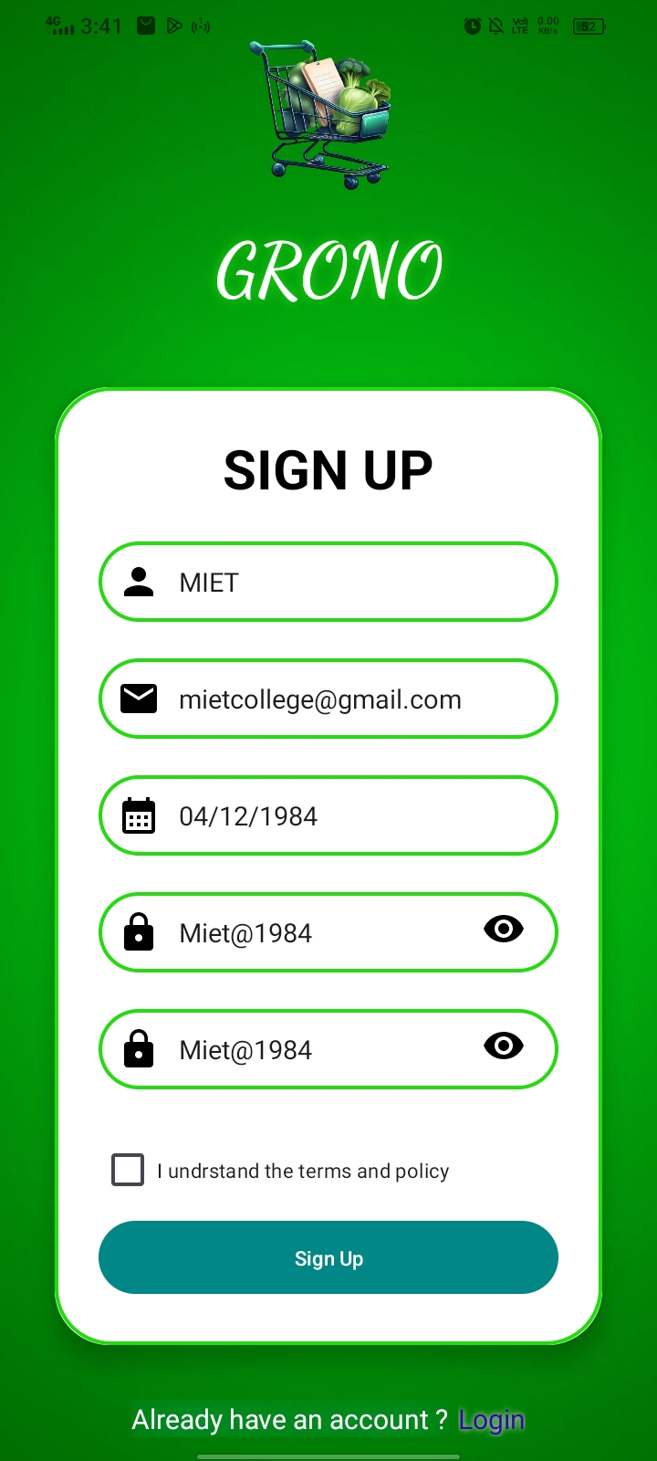
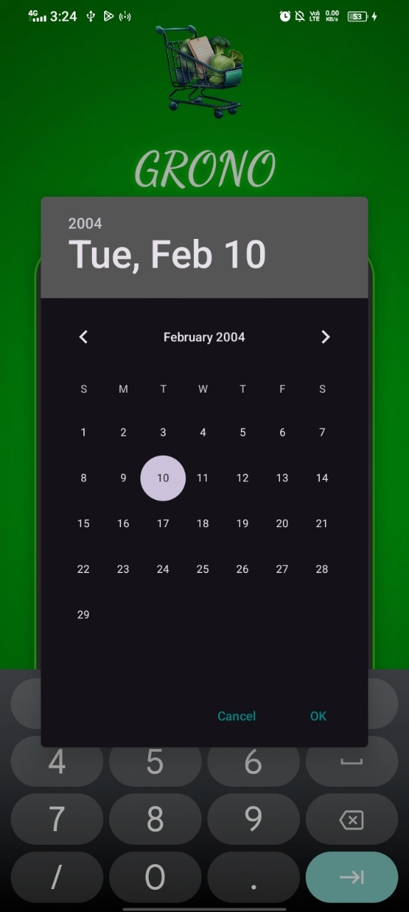
SCREENSHOTS

Slide 25
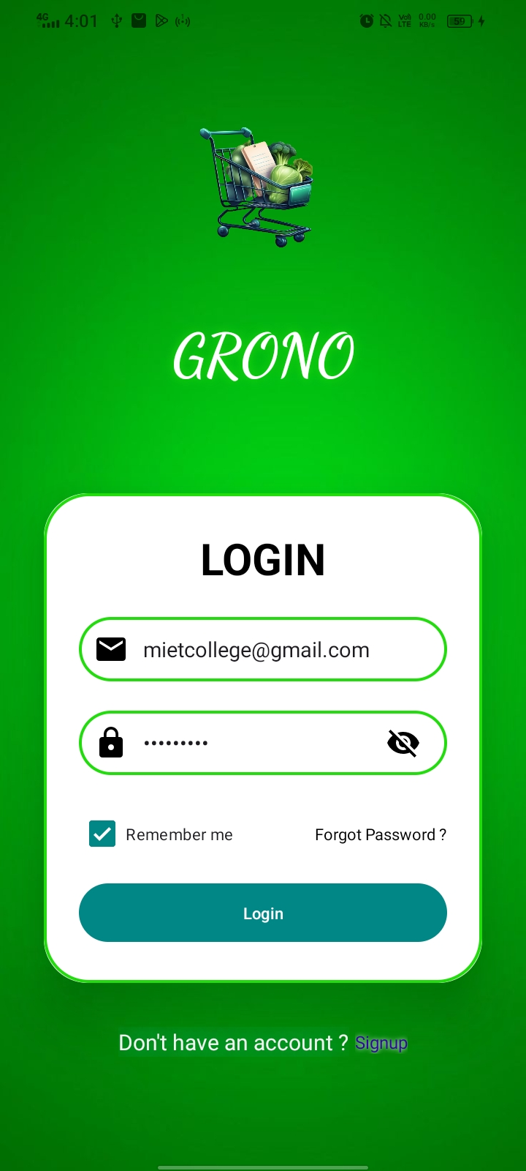
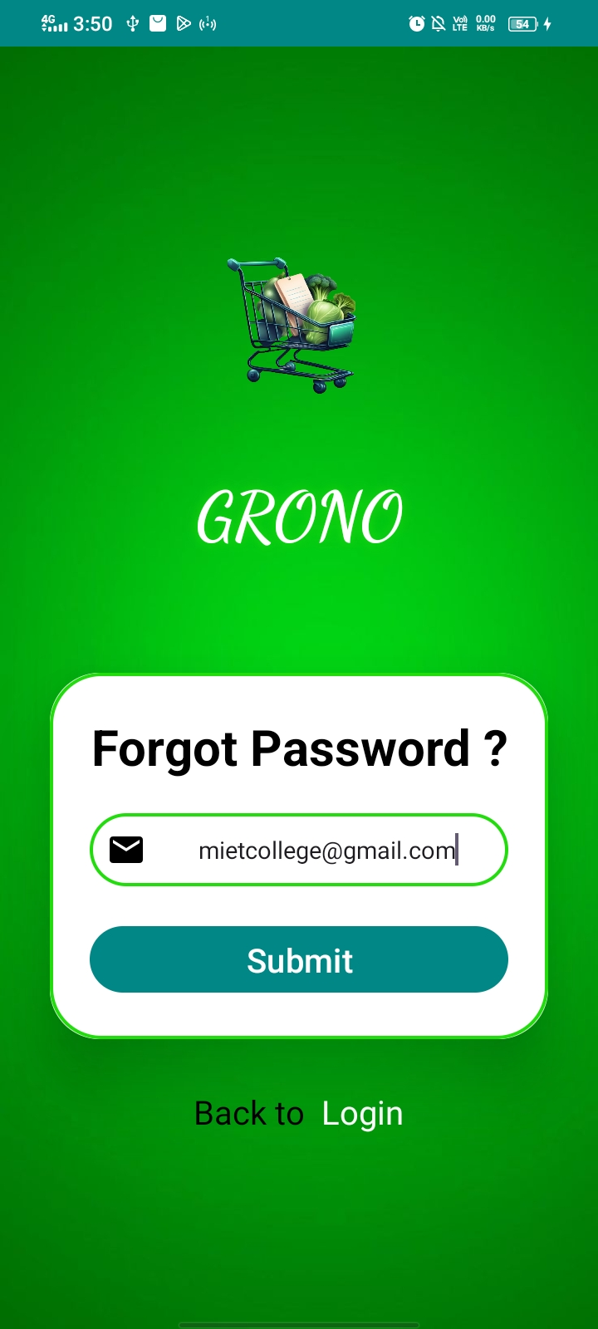
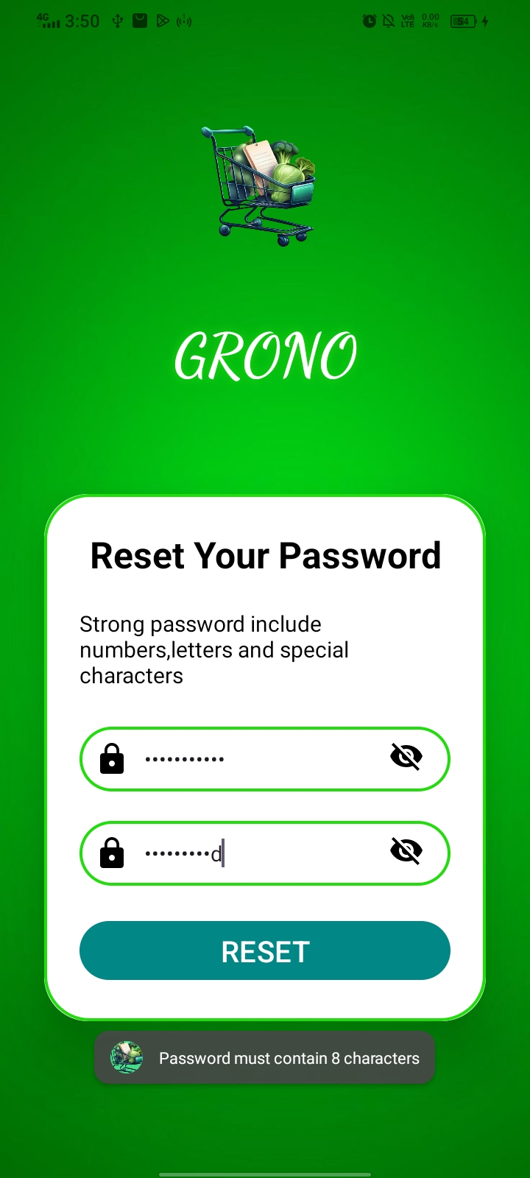

Slide 26
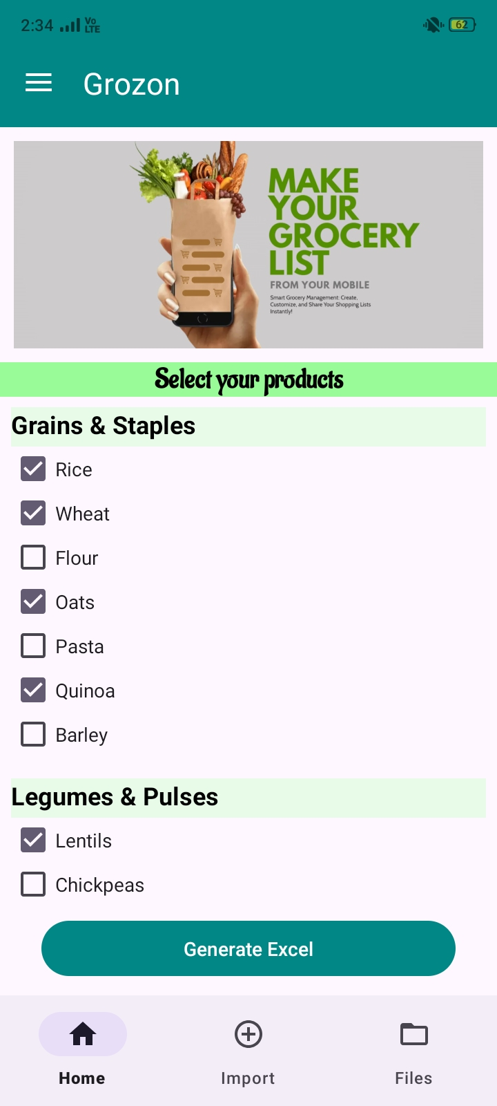
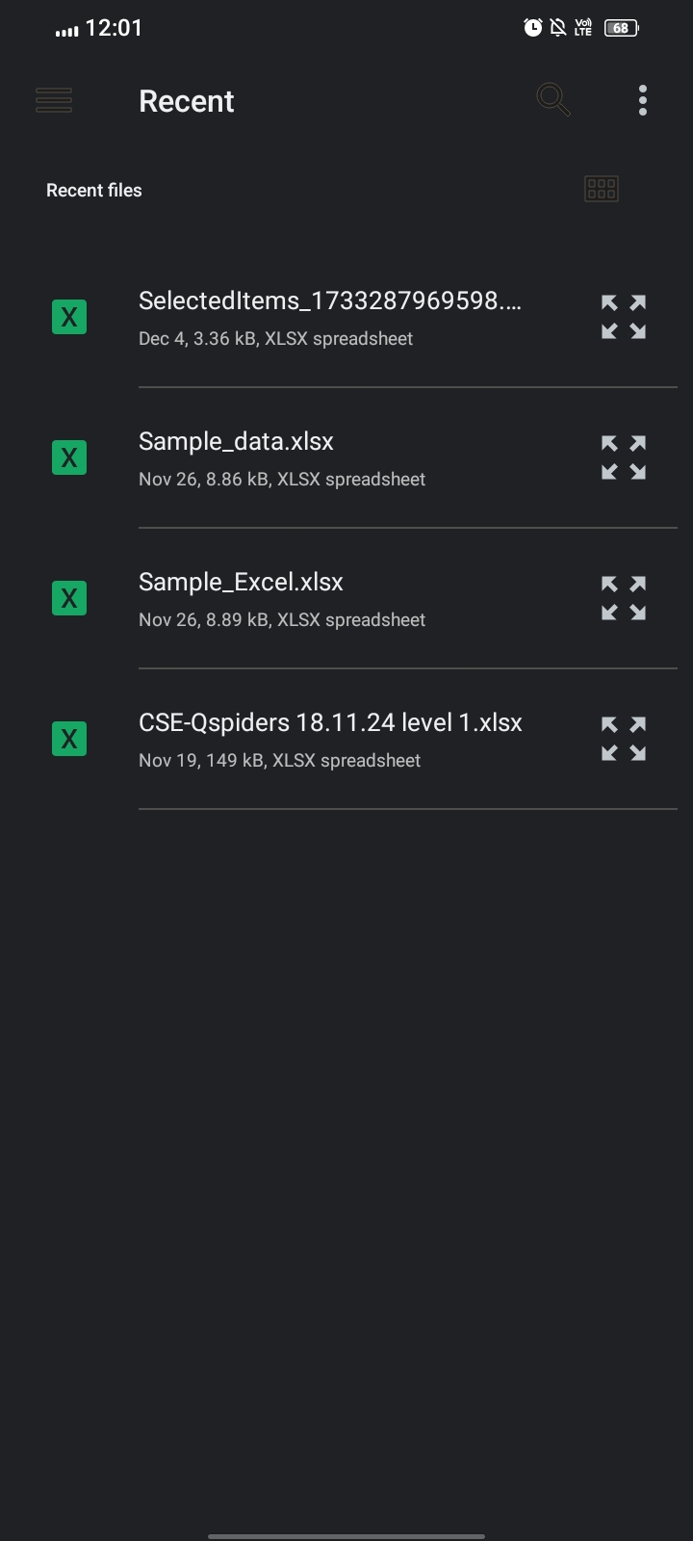

Slide 27
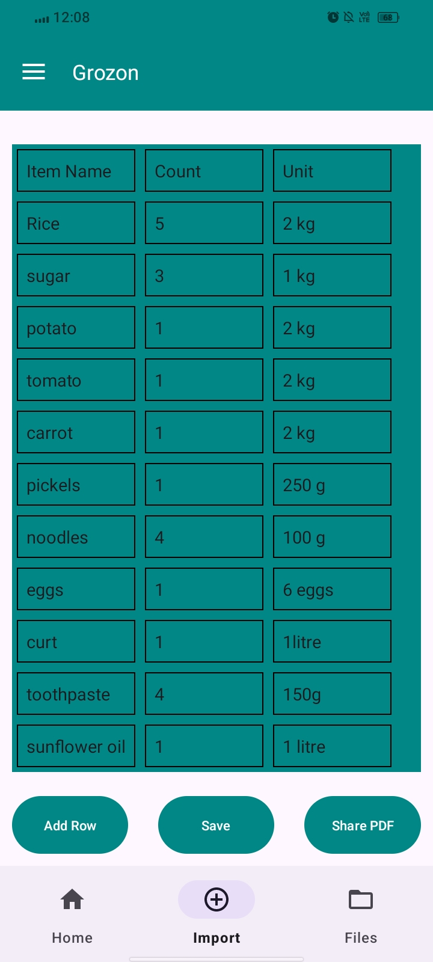
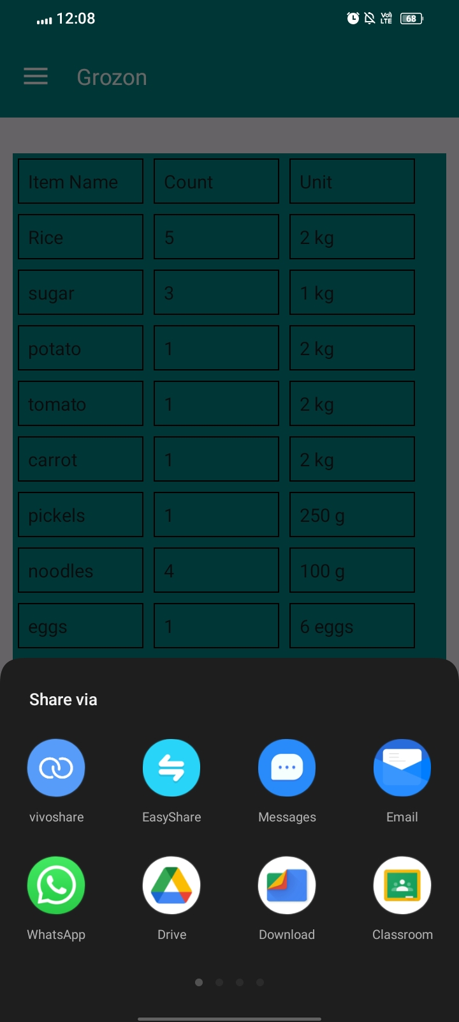
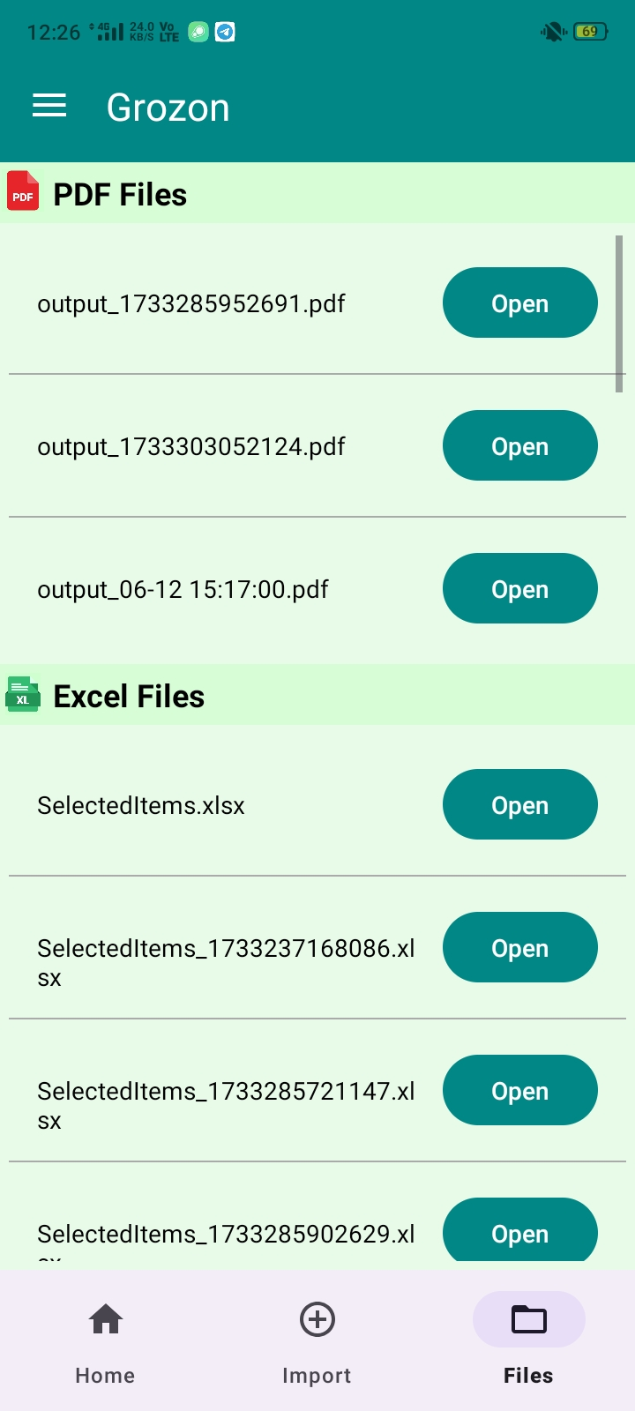

Slide 28
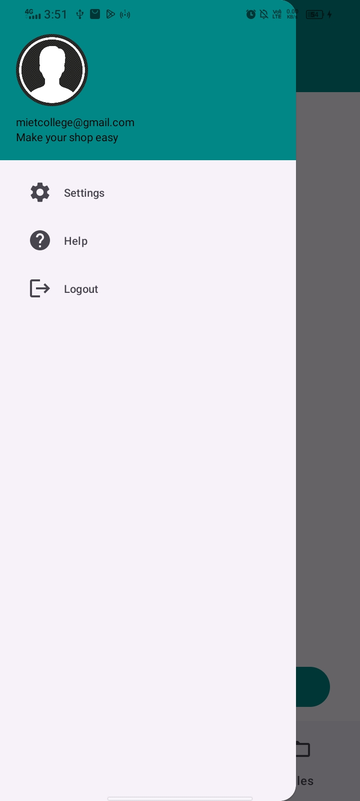

Slide 29
THANK YOU

